Slide 1
SOIL prediction for suitable crops
Using KNN Algorithm

Slide 2
SOil Prediction for suitable crops using KNN algorithm
Major Project
Supervised by- D. Abdul Jaleel
Presented by:-
P. Vishnuvardhan Naidu 19691A28H9
CR. Tejavardhan Reddy 19691A28F8

Slide 3
Contents
ABSTRACT
INTRODUCTION
LITERATURE REVIEW ON TOPIC & METHODOLOGY
RESEARCH GAP
PREVIOUS REVIEW COMMENTS
INCORPORATED MODIFICATIONS
ARCHITECTURE DIGRAM
DATA SET
INPUT AND OUTPUT
METHODOLOGY OF THE PROPOSED WORK IN DETAIL
ALGORITHM USED IN DETAIL
COMPLETE IMPLEMENTATION & DEMO

Slide 4
PROJECT DESIGN - UML DIAGRAMS
COMPLETE IMPLEMENTATION & DEMO
RESULTS & COMPARISION
PLAGARISM REPORT
REFERENCES

Slide 5
abstract
For most developing countries, agriculture is their primary source of revenue. Modern agriculture is a constantly growing approach for agricultural advances and farming techniques.
It becomes challenging for the farmers to satisfy our planet's evolving requirements and the expectations of merchants, customers, etc. Some of the challenges the farmers face are-
Nutrient deficiency in the soil, caused by a shortage of crucial minerals such as potassium, nitrogen, and phosphorus can result in reduced crop growth.
Farmers make a mistake by cultivating the same crops year after year without experimenting with different varieties. Agriculture is the most important supply of Indian Economy.
For the better crop yield, the farmers always require a correct crop that can give good yield in that particular soil. It is predicting the future possible crops that can be sowed in soil with its respective NPK percentages .

Slide 6
Introduction
The primary goal of this study is to examine, evaluate and identify the suitable crop using trained models present in the dataset.
And also increase the accuracy in detecting the prediction of crop by using the KNN Algorithm.
This methodology takes the test samples of the N,P,K values and analyse the ppm values of N,P,K micronutrients respectively.
It recomends the best suitable crop which is suitable for the soil.

Slide 7
LItereature survey on topic
The current system was based on the environment, such as rainfall,humidity and temperature.
The sudden changes in the temperature leads to damage of the crops.
Our methodology makes use of the NPK values of the soil, which reduces the crop damage.
The current system also predicts whether the soil is suitable for farming or not.
Nitrogen(N) : 40-120ppm
Phosphorous(P) : 40-80ppm
Potassium(K) : 40-80ppm

Slide 8
Litereature survey on methodology
K-Nearest Neighbour(KNN) Algorithm for Machine Learning
•K-Closest Neighbour is one of the least difficult AI calculations in view of Managed Learning strategy.
•K-NN calculation expects the closeness between the new case/information and accessible cases and put the new case into the class that is generally like the accessible classes.
•K-NN calculation can be utilized for Relapse as well concerning Grouping yet for the most part it is utilized for the Arrangement issues.
•It is likewise called a languid student calculation since it doesn't gain from the preparation set quickly rather it stores the dataset and at the hour of order, it plays out an activity on the dataset.

Slide 9
identifying the research gap in literature review
The current system was based on the environment, such as rainfall,humidity and temperature.
The sudden changes in the temperature leads to damage of the crops.
Our methodology makes use of the NPK values of the soil, which reduces the crop damage.
It predicts the climatic conditions which may takes place of sudden changes in it, then the probability of crop damage will be more.
The current system also predicts whether the soil is suitable for farming or not.

Slide 10
Previous comments
Asked to include more data set with more number of test samples.
Title modification has to be done.
Proceed with the code implementations

Slide 11
incorporated modifications
We are using the NPK values to make the suitable choice for the soil.
These were used along with the climatic conditions.
All these values predicts the soil
This proposed system also predicts whether the soil is suitable for the farming or not.

Slide 12
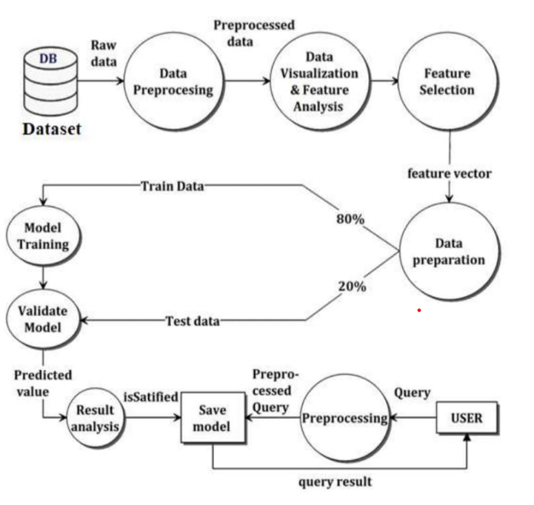
architecture diagram

Slide 13
dataset
Dataset | features | Emotion model | Download linnk
Crop Recommendation Dataset | Precision agriculture is in trend nowadays. It helps the farmers to get informed decision about the farming strategy. | Discrete | https://www.kaggle.com/datasets/atharvaingle/crop-recommendation-dataset?resource=download

Slide 14
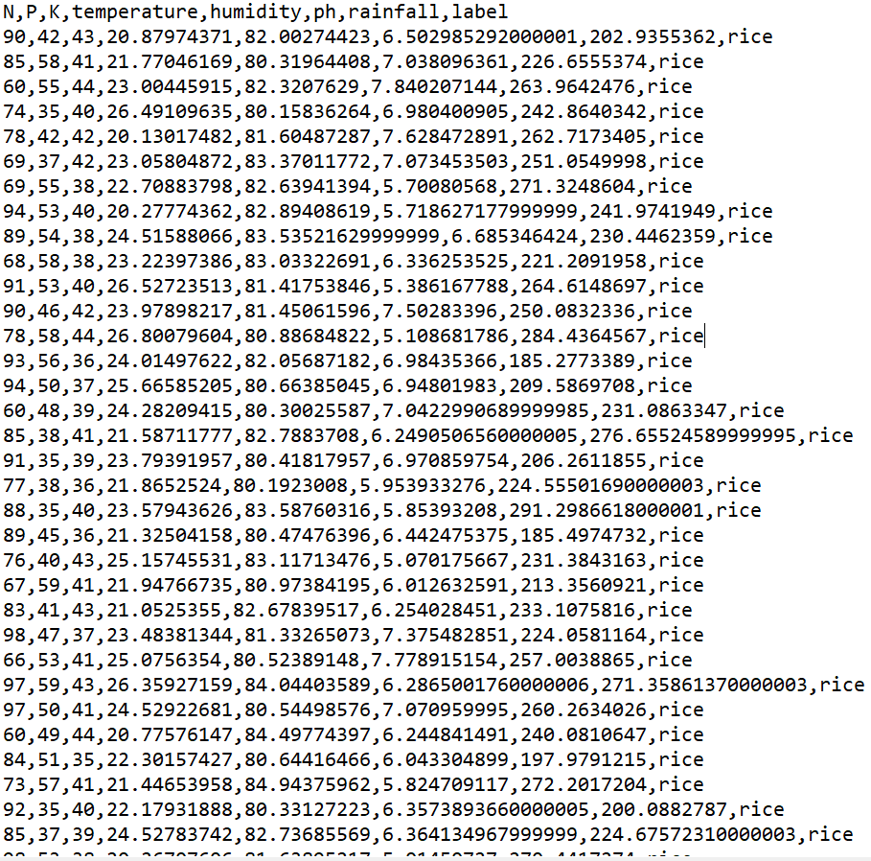
DATASET

Slide 15
Attributes in dataset
Grains | Fruits | Plantation Crops | Legumes/Pulses
Rice | Orange | Coffee | Peas
Maize | Apple | Cotton | Ground nuts
Wheat | Grapes | Jute | Chickpea
 | Pomogranate |  | Kidney beans
 | Banana |  | Pigeon peas
 | Mango |  | Moth beans
 | Water melon |  | Mung beans
 | Musk melon |  | Lentil
 | Papaya |  | Black Grams
 | Coconut

Slide 16
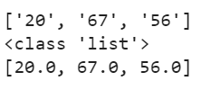
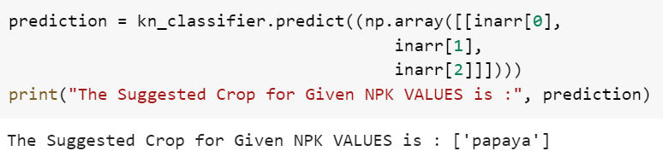
INPUT & OUTPUT
Inputs are the NPK values from the User
Generated output:

Slide 17
METHODOLOGY of the proposed work in detail
This method starts with the training of the dataset.
Once the data gets trained the testing data will be given.
The testing data will be tested based on the features and the levels of NPK in the soil.
Based on the soil fertility, climate and zone the processing will be happen.
At last the data will be given to the user.

Slide 18
algorithm used in detail
K-Nearest Neighbour(KNN) Algorithm for Machine Learning
K-Nearest Neighbour is one of the simplest Machine Learning algorithms based on Supervised Learning technique.
K-NN algorithm assumes the similarity between the new case/data and available cases and put the new case into the category that is most similar to the available categories.
K-NN algorithm can be used for Regression as well as for Classification but mostly it is used for the Classification problems.
It is also called a lazy learner algorithm because it does not learn from the training set immediately instead it stores the dataset and at the time of classification, it performs an action on the dataset.

Slide 19
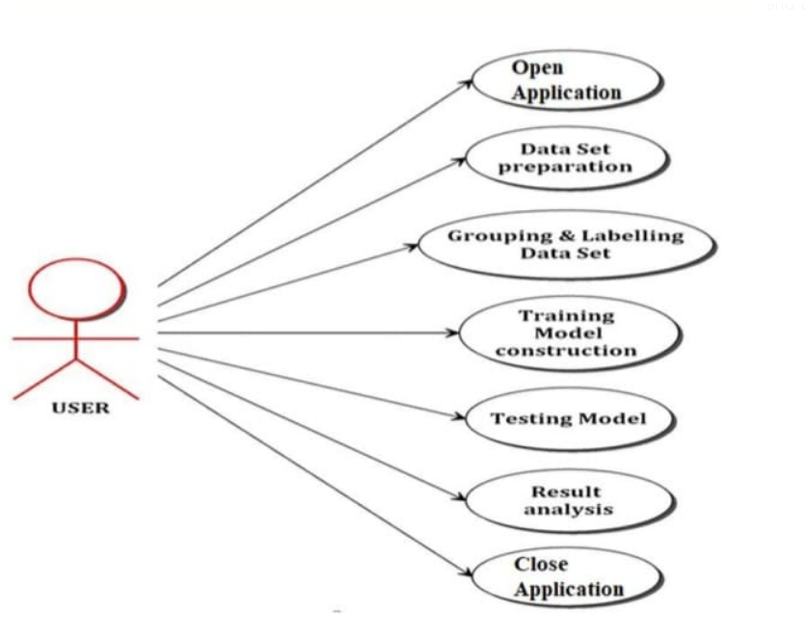
project design-uml diagram usecase

Slide 20
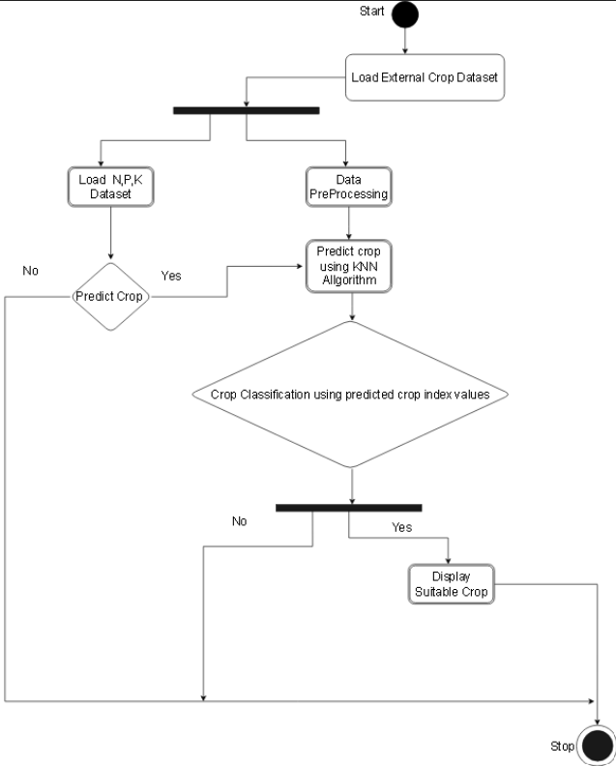
activity diagram:

Slide 21
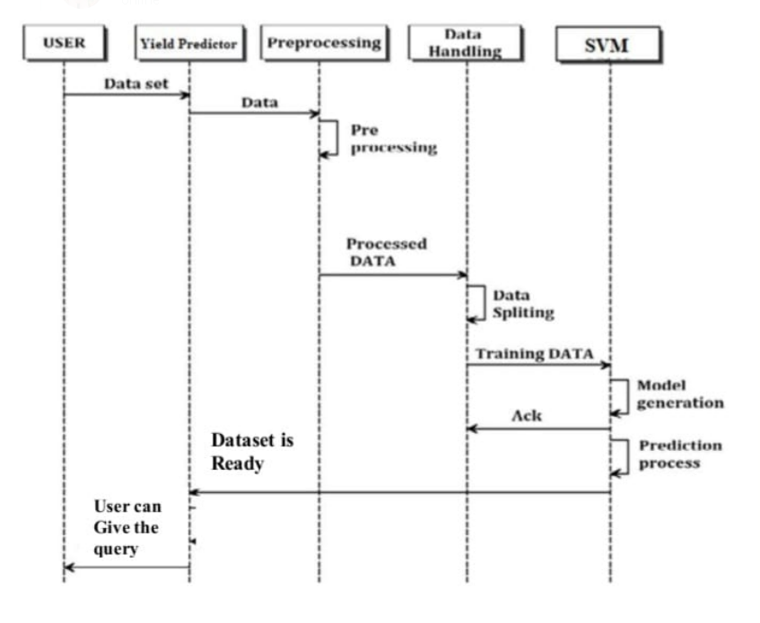
sequence diagrAM

Slide 22
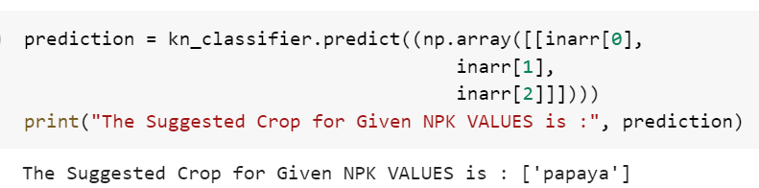
results and comparision
Generated output after the implimentation of the code.

Slide 23
REFERENCES
Rakesh Kumar, M.P. Singh, Prabhat Kumar and J.P. Singh,”Crop Selection Method to Maximize Crop Yield Rate using Machine Learning Technique”,Vel Tech Rangarajan Dr. Sagunthala R&D Institute of Science and Technology, Chennai, T.N., India. 6 - 8 May 2015. pp.138-145
Ramya M, Chetan Balaji, Girish L, “Environment Change Prediction to Adapt Climate-Smart Agriculture Using Big Data Analytics”, International Journal of Advanced Research in Computer Engineering & Technology (IJARCET) Volume 4 Issue 5, May 2015.
QiaoYing,ChenHao,ǁThe Design of smart cloud computing system, International Conference on Computational andInformation Sciences,IEEE,2011.

Slide 24
THANK YOU

